Slide 1
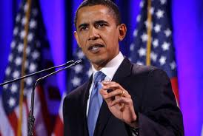
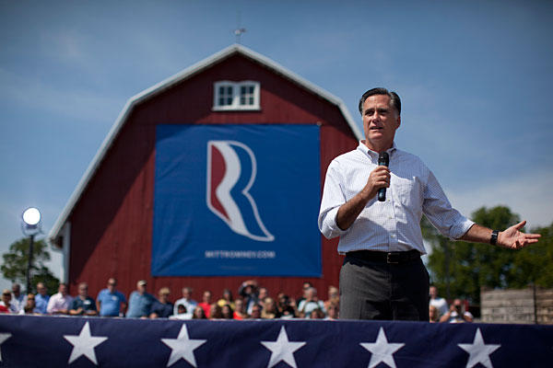
Campaign Strategies
How do candidates help themselves get elected?

Slide 2
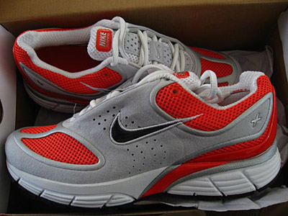
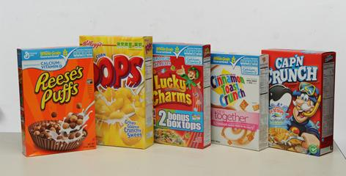
Initial Thoughts
Almost all companies use commercials and advertising to get the public to buy their products. Do you think that a good advertisement can convince people to buy a certain product (for example, one kind of cereal or a specific shoe brand?). Do ads always tell the truth?

Slide 3
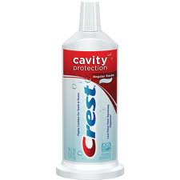
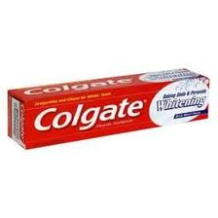
But should you believe all advertisements?
It is important to think critically about advertisements, whether they are trying to get you to buy toothpaste or getting you to vote one way or the other.

Slide 4
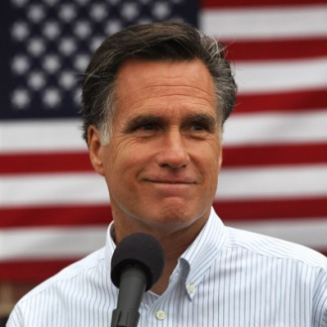
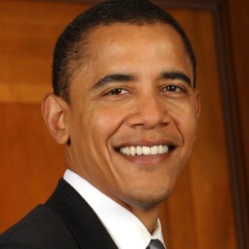
What we’re going to look at:
The logos and slogans of the candidates
Magazine ads
Surprising (and a little bit sneaky) advertising
Television Commercials

Slide 5
Things you should pay attention to
Colors
Font
People
Picture/Video (includes sound in a commercial)

Slide 6
Color

Slide 7
Font
Powerful, Strong
Silly, Fun
Childlike, simple
Fancy, Delicate, Old-fashioned
Plain, straightforward

Slide 8
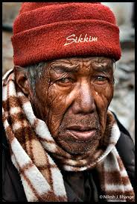
People

Slide 9
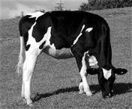
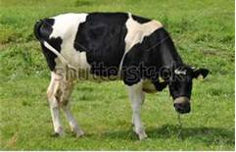
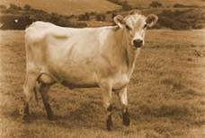
Pictures/Video

Slide 10
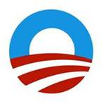
Obama’s Logo and Slogan

Slide 11
Romney’s Logo and Slogan

Slide 12
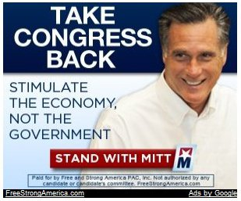
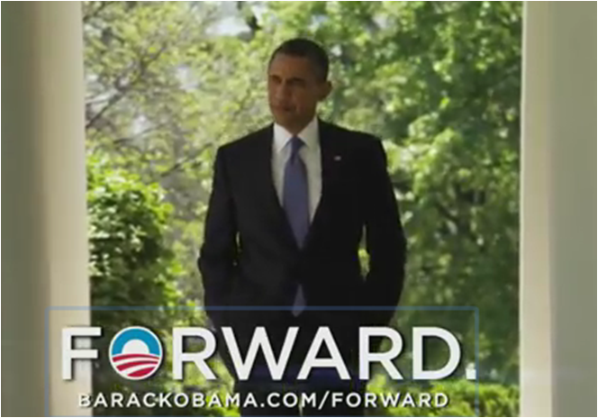
More Ads

Slide 13
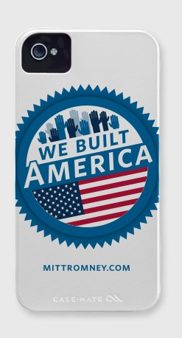
All Kind of Advertising… iPhone Cases
Obama
Romney

Slide 14
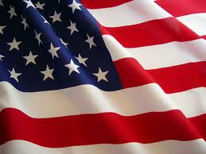
And now…
You are the campaign manager for either Obama or Romney. It is your job to design a piece of campaign paraphernalia for your candidate to get the word it.

