Slide 1
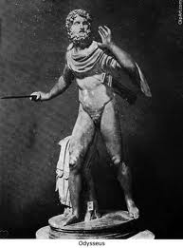
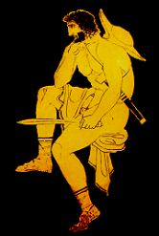
The Epic hero

Slide 2
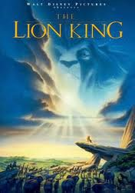
First things first: What is an epic?
Long story (in classical times, a poem) telling of a hero and his adventures
Used to be sung
Reveals the fears and desires of a culture
Often follows a pattern, and almost always contains an EPIC HERO.

Slide 3
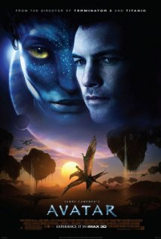
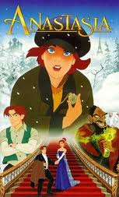
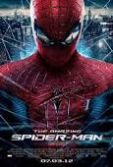
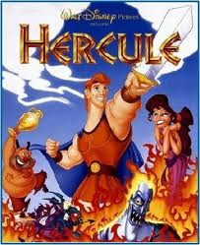
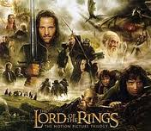
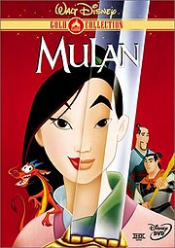
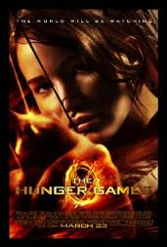
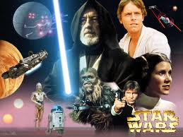
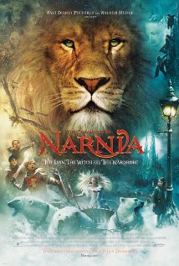
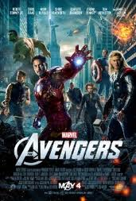
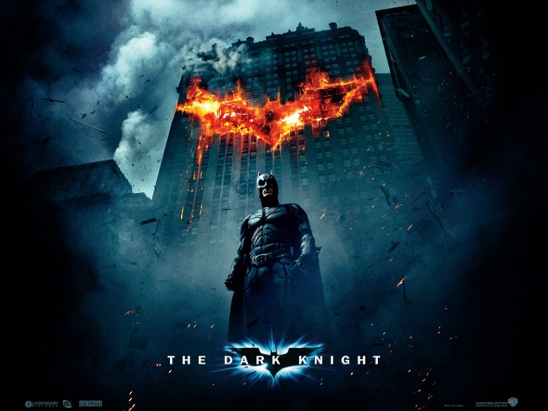
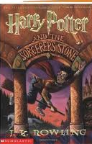
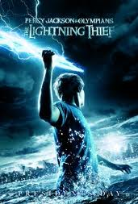
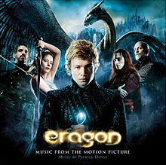
Modern Epics

Slide 4
Personality Traits
The EPIC HERO possesses the qualities most admired by a culture (e.g. courage, determination, wit, wisdom)
“Larger than life” character
Usually (but not always) somehow better the average person, or marked as being important. (For example, he might be a prince.)
In modern epics, the hero is often an average guy/girl who rises to the occasion.

Slide 5
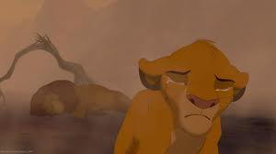
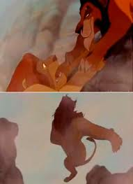
Traumatic Event
Something happens to set the hero on his journey.

Slide 6
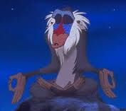
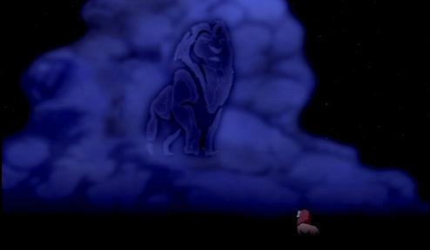
Supernatural Aid
The gods, a fairy grandmother, fate… something helps the hero out a little as he goes on his journey.

Slide 7
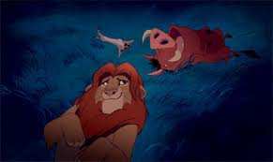
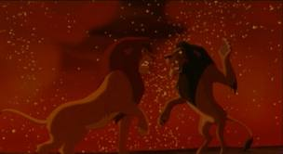
Battles and Hardships
The hero
Fights monsters
Faces demons
Struggles against temptations

Slide 8
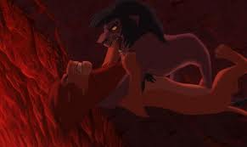
Descent into Darkness
Could be emotional, spiritual, or the hero literally going down into the underworld, but at some point, the hero must face a terrible darkness, whether literally or within him or herself.
This is the darkness right before the dawn
“I killed Mufasa!”

Slide 9
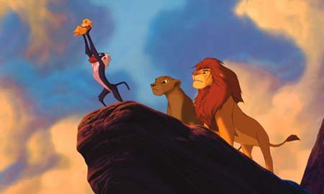
Homecoming
The hero gets a reward. In epic poetry, this is usually a homecoming, although any sense of a spiritual reward or positive ending counts.
In other words, one of the most important elements is this: THE HERO WINS!

Slide 10
Epic Examples!
Your turn to think of an example of a modern-day epic. Choose a book or a movie that you think is a modern epic. On the notetaker, explain how the story follows the elements of an epic hero. At the bottom explain why your hero has the personality of an epic hero.

